Slide 1
Discrete Structures/Mathematics (3 Credit Hour)
Lecture # 01
By
Rubab Anam Janjua

Slide 2
Instructor Email Address:
rubab.anam@nu.edu.pk
Web page of the course:
sites/google.com/site/swarmrobo

Slide 3
Marks Distribution
Assignments (10 %)
Quizzes (15 %)
Midterm Exam (30 %)
During the 8th week.
Duration: 1.5 hour.
Will cover all material covered during the first seven weeks.
Final Exam (45 %)
During the 16th week.
Will cover whole of the course with a slight emphasis on the material cover after the midterm exam.
Duration: 3 hour

Slide 4
Introduction
Discrete structures/mathematics has special relevance to computer science.
Computer is a binary machine and all the algorithms in computer science are based on binary digits 0 and 1. We therefore can say computer is inherently is DISCRETE.

Slide 5
Discrete Vs Continuous Data
Number of boys in the class
Height of a Person
Time in a Race
Number of family members
Number of candies in a packet
Number of suitcases lost by an airline
Distance traveled by a car
??

Slide 6
What is Discrete mathematics / structures?
The word discrete is essentially the opposite of continuous, discontinuous or segregated.
Definition:
“Discrete Mathematics/Structure concerns processes that consist of a sequence of individual steps.”

Slide 7
Example:
Discrete
Continuous

Slide 8
Example:
Set of Integers:
• • • • • •
-3 -2 -1 0 1 2
Set of Real Numbers:
• • • • • • •
-3 -2 -1 0 1 2 3

Slide 9
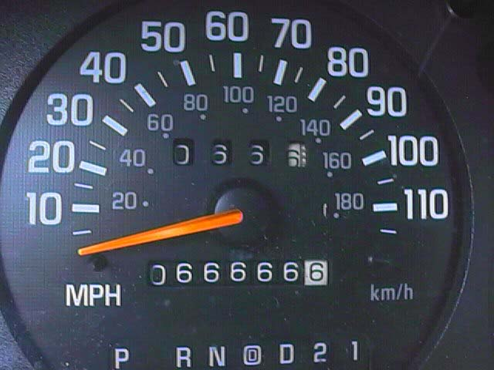
Odometer

Slide 10
Reasons to study discrete Mathematics.
Mathematical Maturity essential to study any scientific discipline.
Prerequisite of number of advance courses i.e.
Data Structures
Algorithm Analysis
Theory of Automata
Computer Theory

Slide 11
Course Objective
Express statements with the precision of formal logic.
Analyze arguments to test their validity.
Apply the basic properties and operations related to sets.
Apply to sets the basic properties and operations related to relations and functions.
Define terms recursively.

Slide 12
Prove a formula using mathematical induction.
Prove statements using direct and indirect methods.
Illustrate the basic definitions of graph theory and properties of graphs.

Slide 13
The kind of problem solved using Discrete Structure Course:
How many ways are there to choose a valid password?
Is there a path connecting two computers in a network?
How can a circuit that adds two integers be designed?
How many valid internet addresses are there?
How can we encrypt credit card information on the web?
What is the probability of winning a lottery?

Slide 14
Recommended Books:
Discrete Mathematics and its application by Kenneth H. Rosen, 7th edition.
Discrete Mathematics with applications by Susanna S. Epp.
Discrete Mathematics by Ross and Wright

Slide 15
Class Activity
An island that has two kinds of inhabitants, knights, who always tell the truth, and their opposites, knaves, who always lie.
You encounter two people A and B.
What are A and B if A says "B is a knight"
and B says “.The two of us are opposite types"?

Slide 16
Home Activity
Example: Determine that in how many ways can three prizes be shared among 4 boys when
i) No one gets more than one prize.
ii) A boy can get any number of prizes.

Slide 17
Main Topics:
Logic
Sets & Operations on sets
Relations & Their Properties
Functions
Sequences & Series
Recurrence Relations
Mathematical Induction
Methods of Proof
Combinatorics
Probability
Graphs and Trees

Slide 18
Logic
Logic rules and principles is to distinguish an argument is valid or invalid.
Def:
“Logic is the study of the principles and methods that distinguishes between a valid and an invalid argument.”

Slide 19
PROPOSITION
A statement/proposition is a declarative sentence which is either TRUE or FALSE but not both.
A statement is also referred to as Proposition.
Example:
2+2 = 4
It is Sunday today
If a proposition is true, we say that it has a truth value of "true”.
If a proposition is false, its truth value is "false".
The truth values “true” and “false” are, respectively, denoted by the letters T and F.

Slide 20

Examples:
Statement Truth Value
Grass is green.
4 + 2 = 6
4 + 2 = 7
There are four fingers in a hand.

Slide 21
NOT Propositions
Close the door.
x is greater than 2.
He is very rich (though is a declarative statement but we don’t know about pronoun he)

Slide 22
Rule:
If the sentence is preceded by other sentences that make the pronoun or variable reference clear, then the sentence is a statement.
Example
Bill Gates is an American
He is very rich
He is very rich is a statement with truth-value TRUE.

Slide 23
Example:
x = 1
x > 2
x > 2 is a statement with truth-value FALSE.

Slide 24
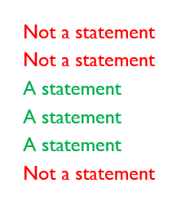
UNDERSTANDING STATEMENTS
x + 2 is positive.
May I come in?
Logic is interesting.
It is hot today.
-1 > 0
x + y = 12

Slide 25
COMPOUND STATEMENT
Def:
“Simple statements could be used to build a compound statement.”
Examples:
“3 + 2 = 5” and “Lahore is a city in Pakistan”
“The grass is green” or “ It is hot today”
“Discrete Structure is not difficult to me”
AND, OR, NOT are called LOGICAL CONNECTIVES.

Slide 26
SYMBOLIC REPRESENTATION
Statements are symbolically represented by letters such as p, q, r,...
EXAMPLES:
p = “Islamabad is the capital of Pakistan”
q = “17 is divisible by 3”

Slide 27
LOGICAL CONNECTIVES
CONNECTIV | MEANING | SYMBOL | CALLED
Negation | not | ~ | Tilde
Conjunction | and | ∧ | Hat
Disjunction | or | ∨ | Vel
Conditional | if…then… | → | Arrow
Biconditional | if and only if | ↔ | Double arrow

Slide 28
EXAMPLES:
p = “Islamabad is the capital of Pakistan”
q = “17 is divisible by 3”
p ∧ q = “Islamabad is the capital of Pakistan and 17 is divisible by 3”
p ∨ q = “Islamabad is the capital of Pakistan or 17 is divisible by 3”
~p = “It is not the case that Islamabad is the capital of Pakistan” or simply “Islamabad is not the capital of Pakistan”

Slide 29
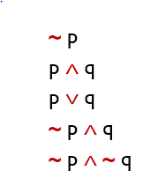
TRANSLATING FROM ENGLISH TO SYMBOLS:
Let p = “It is hot”, and q = “It is sunny”
SENTENCE SYMBOLIC FORM
It is not hot.
It is hot and sunny.
It is hot or sunny.
It is not hot but sunny.
It is neither hot nor sunny.

Slide 30
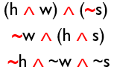
EXAMPLE:
Let h = “Ali is healthy”
w = “Ali is wealthy”
s = “Ali is wise”
SENTENCE SYMBOLIC FORM
Ali is healthy and wealthy but not wise.
Ali is not wealthy but he is healthy and wise.
Ali is neither healthy, wealthy nor wise.

Slide 31
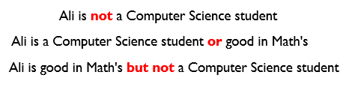
TRANSLATING FROM SYMBOLS TO ENGLISH
Let m = “Ali is good in Mathematics”
c = “Ali is a Computer Science student”
SYMBOLIC FORM STATEMENTS
~ c
c ∨ m
m ∧ ~c

Slide 32
TRUTH TABLE
A convenient method for analyzing a compound statement is to make a truth table for it.
A truth table specifies the truth value of a compound proposition for all possible truth values of its constituent propositions.

Slide 33
NEGATION (~)
If p is a statement variable, then negation of p, “not p”, is denoted as “~p”
It has opposite truth value from p i.e.,
if p is true, ~p is false; if p is false, ~p is true.

Slide 34
TRUTH TABLE FOR ~p
p | ~ p
T | F
F | T

Slide 35
CONJUCTION (∧)
If p and q are statements, then the conjunction of p and q is “p and q”, denoted as “p ∧ q”.
It is true when, and only when, both p and q are true. If either p or q is false, or if both are false, p ∧ q is false.

Slide 36
TRUTH TABLE FOR (p ∧ q)
p | q | p ∧ q
T | T | T
T | F | F
F | T | F
F | F | F

Slide 37
DISJUNCTION (∨)
If p & q are statements, then the disjunction of p and q is “p or q”, denoted as “p ∨ q”.
It is true when at least one of p or q is true and is false only when both p and q are false.

Slide 38
TRUTH TABLE FOR (p ∨ q)
p | q | p ∨ q
T | T | T
T | F | T
F | T | T
F | F | F

